Slide 1
Data Analysis and Visualization Software
Sean Phelan

Slide 2
Long Term Goals and Future Applications
I am a statistics major, and will be doing research next semester; both will require the analysis of many datasets.
For data exploration and transformation, this software will speed up my workflow and allow me to quickly analyze trends within many datasets.
Specifically, I will be able to quickly perform data cleaning and perform exploratory data analysis using this software.

Slide 3
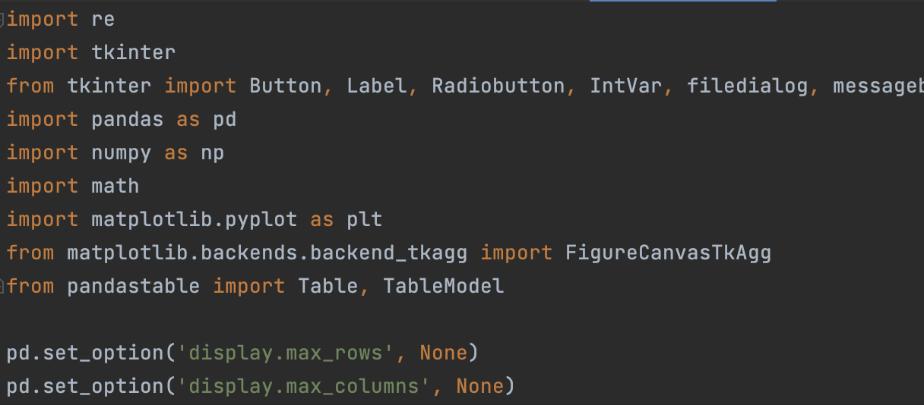
Libraries Used
Tkinter for gui
Pandas for data management and analysis
Numpy for calculations
Matplotlib.pyplot for data visualization
Re for text parsing

Slide 4
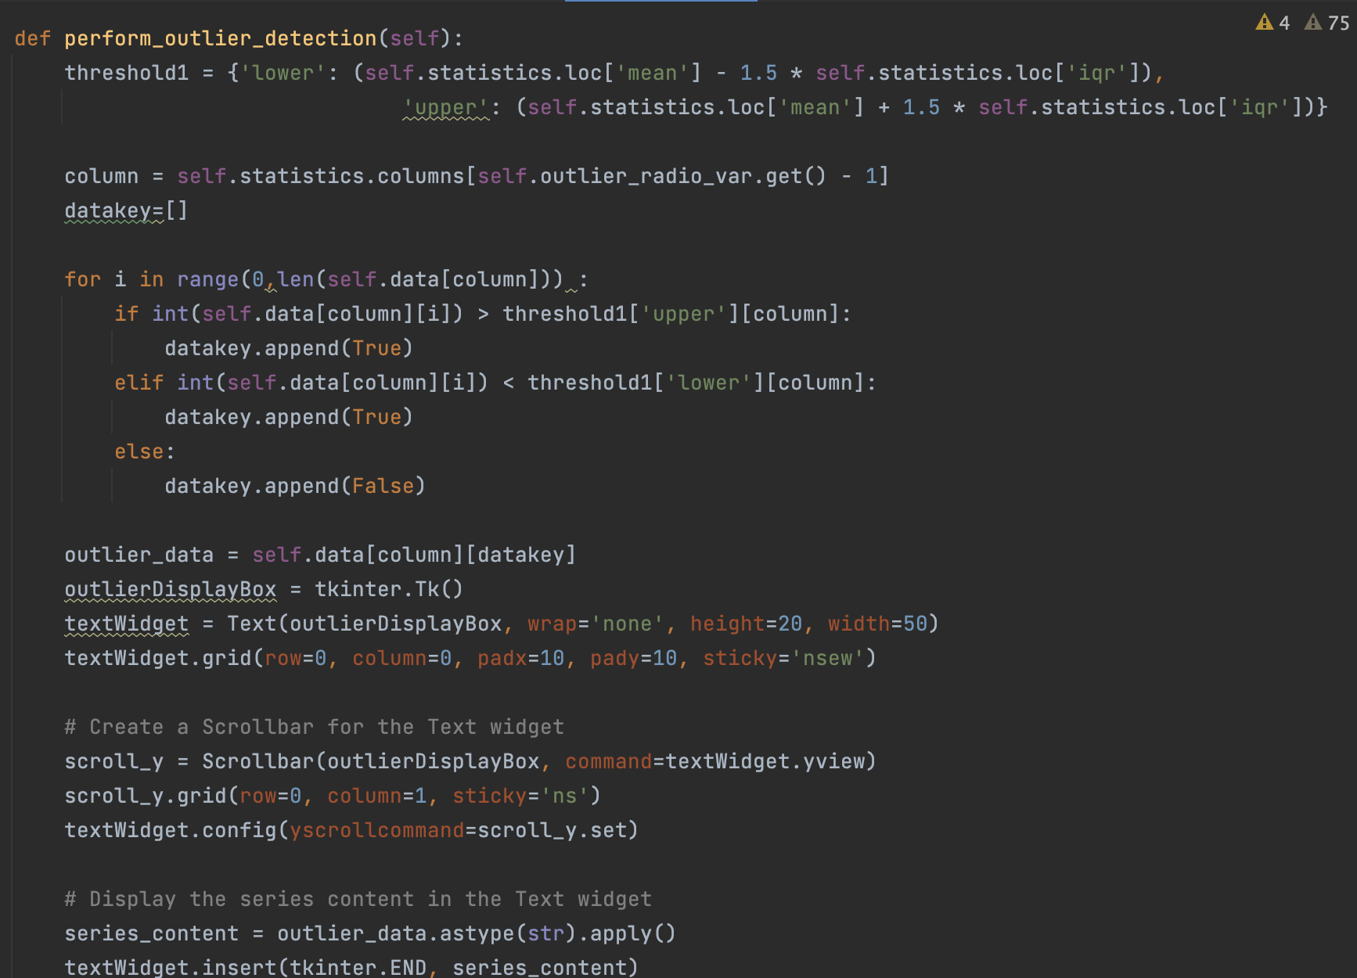
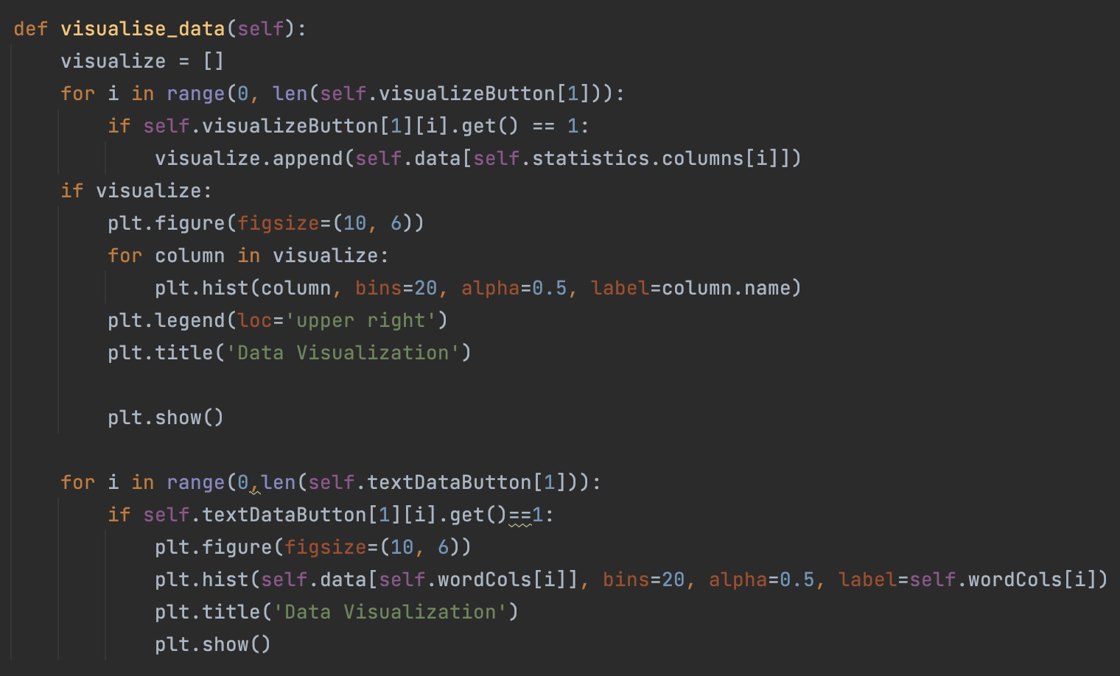
We have many modules in this program, at least one per button

Slide 5
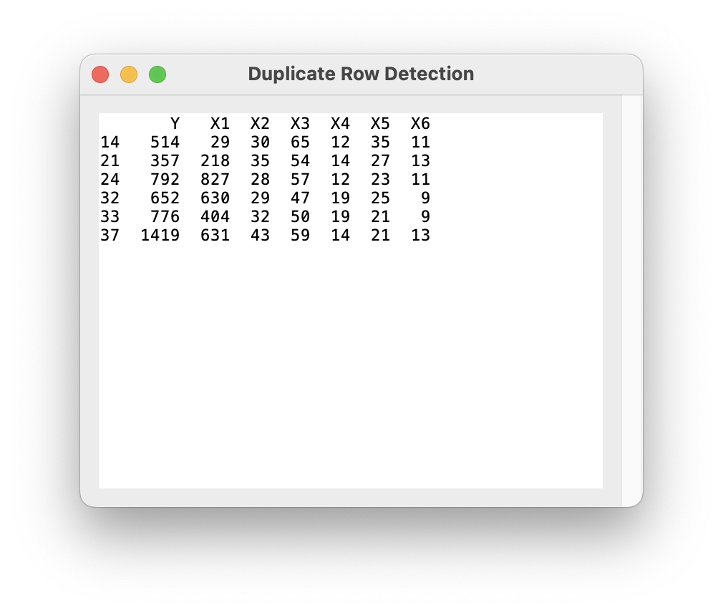
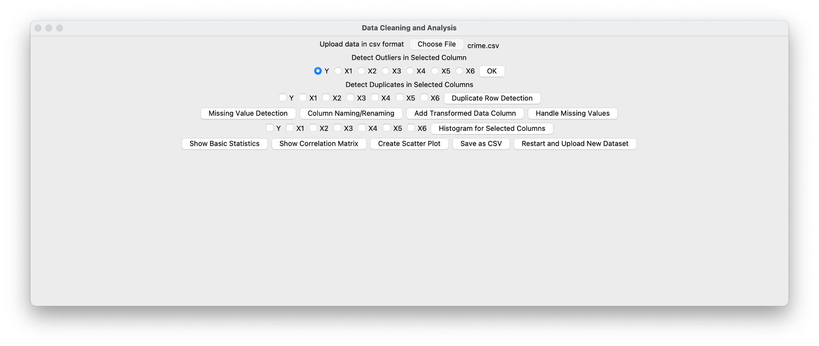
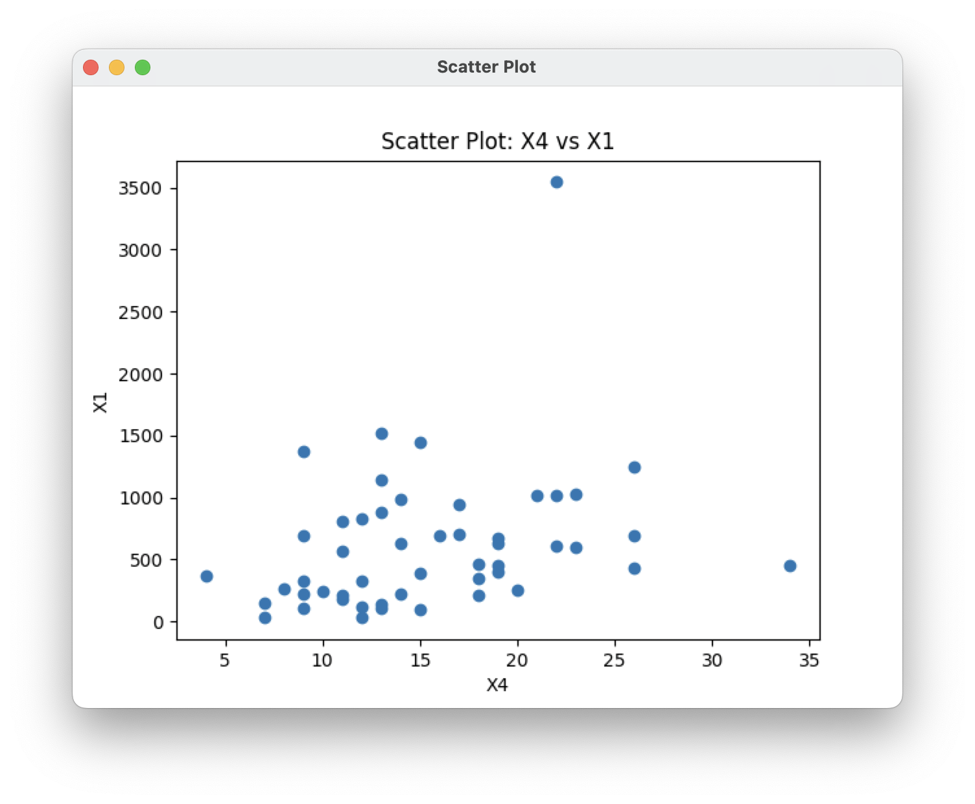
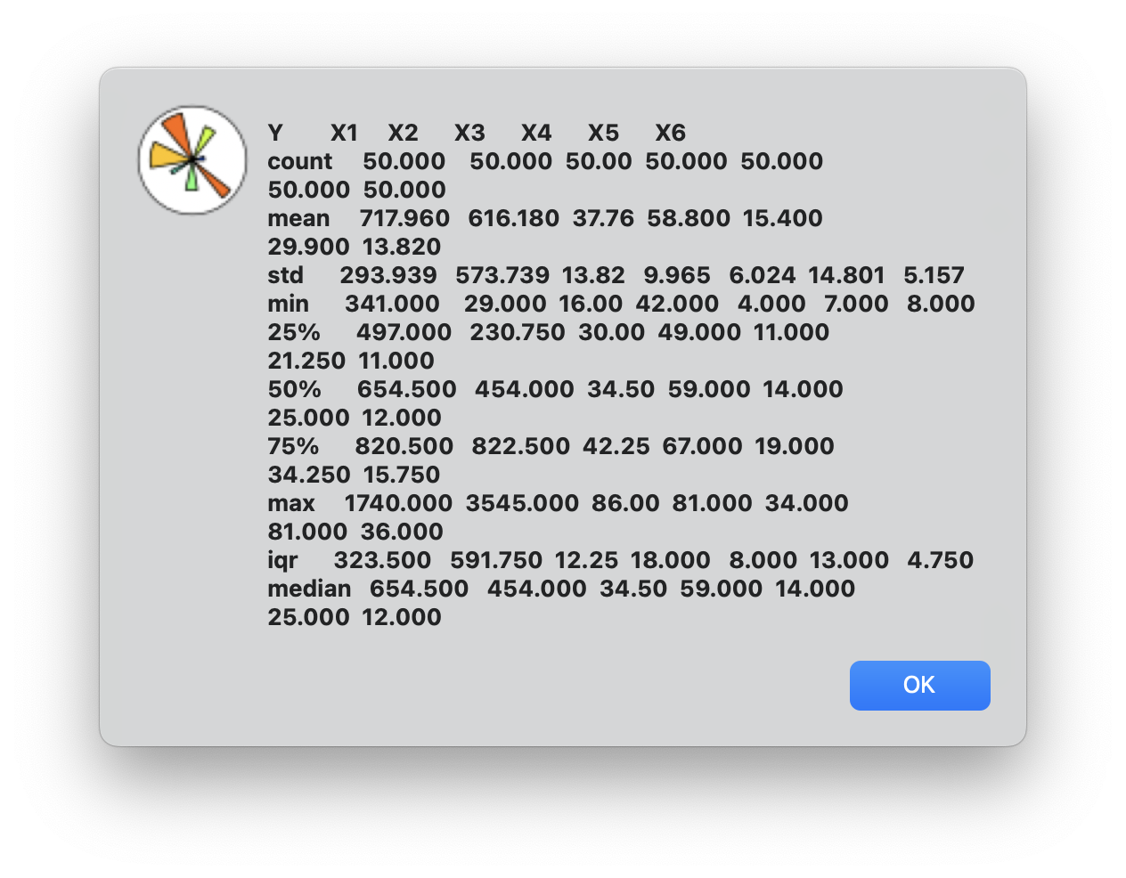
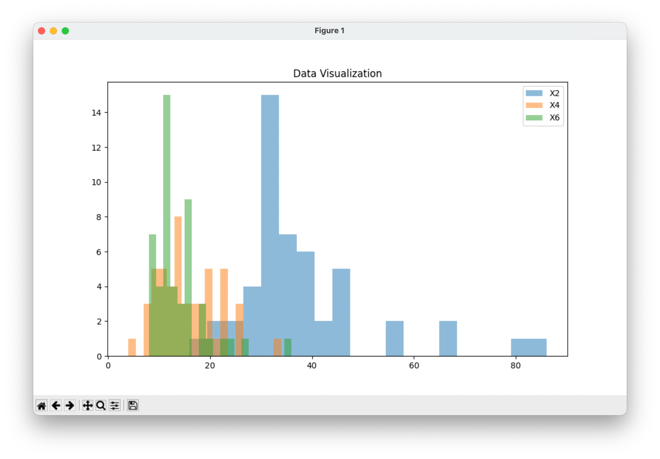
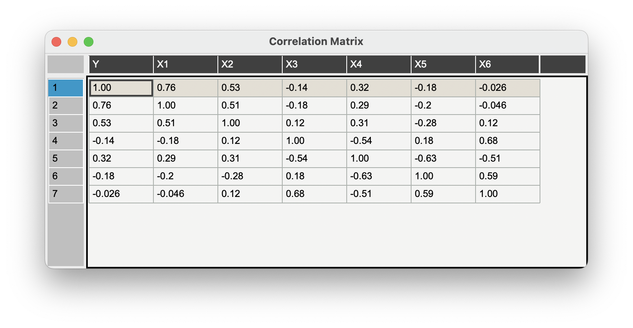
Here is the main UI with a .csv file already loaded. Here are some of the button outputs.

